Slide 1
DSD call
Best practices for drafting proposals
Slides available at :
https://www.sesarju.eu/node/4257

Slide 2
Agenda & Objectives
Slides available at :
https://www.sesarju.eu/node/4257
Agenda
Welcome
Best Practices
Q&A
Objectives
SESAR 3JU & CINEA to propose a set of “best practices” that could improve the quality of the proposals without committing to the outcomes of the evaluation.
Run an open Q&A session

Slide 3
BEST PRACTICES

Slide 4
Set of best Practices – ATM content related
Scope of the project
Make sure that your proposal fits within the scope of the CEF Work Programme and the CEF Transport call for proposals/topic for which you are applying;
Project description / abstract
Be factual;
Avoid technical language;
Can any reader not familiar with the subject understand what the project will be about?
Quantify improvements/benefits expected whenever possible (reduced travel time, reduced Co2 emissions, improved safety,…)

Slide 5
Set of best Practices – ATM content related
Highlight the EU added value brought by the proposal
Describe the strong link to the ATM Master Plan (European ATM policy document) and Airspace Architecture Study;
Describe how the DSD will accelerate market uptake across the EU
Describe how the standardisation and regulatory needs (e.g. certification) will be addressed (if required);
Ensure the involvement of the EASA and NSAs when required;
Develop and strengthen the Dissemination & Exploitation activities;
Address a cross-border geographical scope (e.g. network and en-route scope) and/or a multi-countries applicability (e.g. different airports in different countries);
Involve a diversity of ATM stakeholders (e.g. Airline, ANSPS, Airport, NM…);
Respect the targeted maturity level TRL8 as defined in the Technical specifications;

Slide 6
Pay attention to the terminology of the CEF Programme
Project: the term ‘project’ used in the call text, application form and other documents is synonymous to the term ‘action’ used in the CEF Regulation (see definition article 2).
Article 2 (CEF Regulation 2021/1153): “action” means any activity which has been identified as financially and technically independent, has a set time-frame and is necessary for the implementation of a project.
Work Package: a Work Package (WP) is a major subdivision of the project:
Example: Project Management or preparation of Detailed Design
WPs can run in parallel and/or be sequential
Task: subdivision of a Work Package
Example: Within WP “Project Management”: organizing coordination meetings, ensuring accounting and relevant audits, ensuring technical monitoring of the project.

Slide 7
Set of best Practices – Process related
Propose a realistic budget in line with the ambition of the Demonstrator and according to the time line of the Project;
Prepare in advance by reading the entire documentation in due time (to avoid trivial questions at the last moment);
Set up consortia as big as they are required for executing the Demonstrator.

Slide 8
EASA in the Programme
Along the preparation and execution of the Demonstration activities, care shall be taken on the need to engage with the National Authorities and EASA (when required), to address the regulatory issues.
When relevant, projects shall anticipate the contribution of EASA in the Proposal with associated effort.
EASA contribution may include:
Coordinating the review of the safety argumentation with the competent authorities involved
Provide guidance to support the safety review.
Supporting the approval and endorsement of the safety cases
…
Contact during the proposal elaboration phase: SESAR_requests@easa.europa.eu

Slide 9
Need Help?
Online Manual: Step-by-step online guidance
IT-How-to: IT guidance with screenshots
IT helpdesk: Contact the IT helpdesk for questions such as forgotten passwords, access rights and roles, technical aspects of submission of proposals, etc.
FAQ related to the ‘submission of proposals’ process
Call related questions: CINEA-CEF-TRANSPORT-CALLS@ec.europa.eu
Service desk: EC-FUNDING-TENDER-SERVICE-DESK@ec.europa.eu +32 2 29 92222

Slide 10
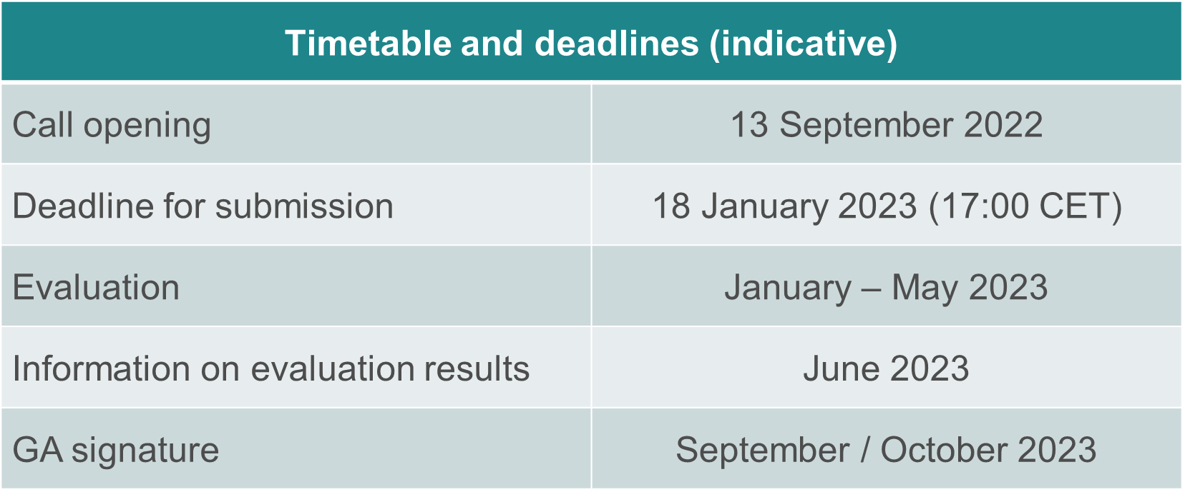
Timetable and deadlines

Slide 11
Answer to received Questions

Slide 12
Can Associated Countries be eligible for funding? (1/2)
Answer
Eligible beneficiaries in the CEF Transport programme are legal entities established either in an EU Member State or legal entities established in a third country associated to the CEF programme as defined in: https://ec.europa.eu/info/funding-tenders/opportunities/docs/2021-2027/c...
Given that at present no neighboring / third countries are associated to the CEF Transport programme, entities from neighboring / third countries are in principle not eligible to receive CEF funding.
Nevertheless, legal entities established in a third country are exceptionally eligible to receive CEF funding where this is indispensable for the achievement of the objectives of a project of common interest. Applicants wishing to be exceptionally considered should submit:
The Letter of Support of the concerned EU Member State
In Part B, in the Project Description, an explanation why the participation of the third country / neighboring entity is indispensable for the project, when applicable/necessary under the points 1.4 Cross-border link (under Priority & Urgency, screenshot below), 3.2 Consortium set-up, governance and organisational structure (under Quality), 4.3 Other considerations (under Impact), and 5.3 Stakeholder commitment (under catalytic effect), and
In the event of works taking place outside the EU, the agreement of the concerned neighboring / third country involved.

Slide 13
Can Associated Countries be eligible for funding? (2/2)
Please also check :
FAQ ID 20888 published in the Portal
FAQ ID 17491 Under CEF Transport, are projects located outside the EU eligible?
FAQ ID 17351 Under CEF Transport, can applicants from non-EU Member States (third countries) participate in these calls?

Slide 14
Can you apply without any precedent EU application?
Answer
Yes you can.
However it is important to note that you have to demonstrate your operational capacity i.e. your experience of implementing the type of projects for which you are requesting EU funds and previous experience of managing EU funding projects of the same size.
If you apply as part of a partnership, some of your partners may well have that experience and therefore you can describe how the roles and responsibilities will be shared based on the different partners’ experiences.
Please refer to section 7. Financial and operational capacity and exclusion of the call document.

Slide 15
Can you please detail the considerations and constraints to be taken in account in the DSD projects with regards to purchase costs, and in particular equipment purchase?
CEF MGA – article 6.2 Specific eligibility conditions for each budget category - C2 Equipment
Purchases of equipment, infrastructure or other assets specifically for the action (or developed as part of the action tasks) may be declared as full capitalised costs if they fulfil the cost eligibility conditions applicable to their respective cost categories.
If equipment, infrastructure or other assets are rented or leased, full costs for renting or leasing are eligible, if they do not exceed the depreciation costs of similar equipment, infrastructure or assets and do not include any financing fees
FAQ ID 18015 published on 05/10/2022

Slide 16
Could you please share a timeline of the relevant steps?

Slide 17
Can “virtual operations centers“ of Airports managing flight operations and its data also be considered under the second program (call)?
Answer
The topic covers the demonstration of the delegation of ATS using Virtual centres; airports are not under scope of the topic.

Slide 18
What security methods will the Virtual Center concept use?
Answer
The Security Risk Assessment methodology (SecRAM) is applicable to any project in DES calls, including DSDs (TRL8). For that purpose, the methodology has been reviewed and updated and will be available for the execution of the projects at the Kick-Off meeting.

Slide 19
Will all Enablers used/matured in a DSD proposal have to target the same maturity level (i.e. TRL8 in this case)?
Answer
We are expecting SESAR Solution(s) to reach TRL8; each SESAR Solution may rely upon one or several required enablers, which must be at the same level of maturity. In any case, regulatory body (either EASA and/or NSA) will not give their authorization on a partial scope (if some required enablers are not at same maturity level)

Slide 20
What support is offered by SJU to coordinate project proposals among the interested industry partners?
Answer
This is an open call under the responsibility of CINEA for all related Grant management activities.
SESAR 3 JU role will focus on the technical oversight of the awarded projects (in coordination with CINEA) and may not be involved in the preparation of the proposals.

Slide 21
How will the Governance incentify ANSPs to move from a CAPEX only to OPEX being given credit and incentives too?
Answer
A key objective of the SESAR 3 Work Programme is to increase the market uptake for a critical mass of early movers;
The approach relies on the launch of demonstrators that offer viable means to build confidence and to bridge from research through industrialisation to implementation.
CAPEX and OPEX related to the demonstration activities are eligible costs (ref also to slide 15 & FAQ ID 18015 published on 05/10/2022).

Slide 22
DSD call
Best practices for drafting proposals
Slides available at :
https://www.sesarju.eu/node/4257

